Slide 1
CEng 240 – Spring 2021 Week 1
Sinan Kalkan
Introduction,
Basic Computer Organization
Disclaimer: Figures without reference are from either from “Introduction to programming concepts with case studies in Python” or “Programming with Python for Engineers”, which are both co-authored by me.

Slide 2
This Week
Introduction
Course content, objectives, outline; Grading; Information about the homeworks, the labs, the exams.
Basic computer organization:
What is computing, programming
Von Neumann Architecture, CPU & Memory
Fetch, decode, execute cycle
Machine code + assembler
BIOS, OS

Slide 3
Introduction to the Course
Objectives
This course gives a brief introduction to a working understanding of basic computer organization, data representation, programming language constructs, and algorithmic thinking. It is designed as a first course of programming and supported by laboratory sessions for students outside of the Computer Engineering major.
Textbook
Programming with Python for Engineers, by S. Kalkan, O. T. Şehitoğlu and G. Üçoluk.
Course Information
https://ceng240.github.io/
Contact
240@ceng.metu.edu.tr
Check ODTUCLASS regularly for announcements.
Course conduct
2-hour live sessions with instructors.
Office hours with the assistants.
Lab exams.
Midterm exam and final exam.

Slide 4
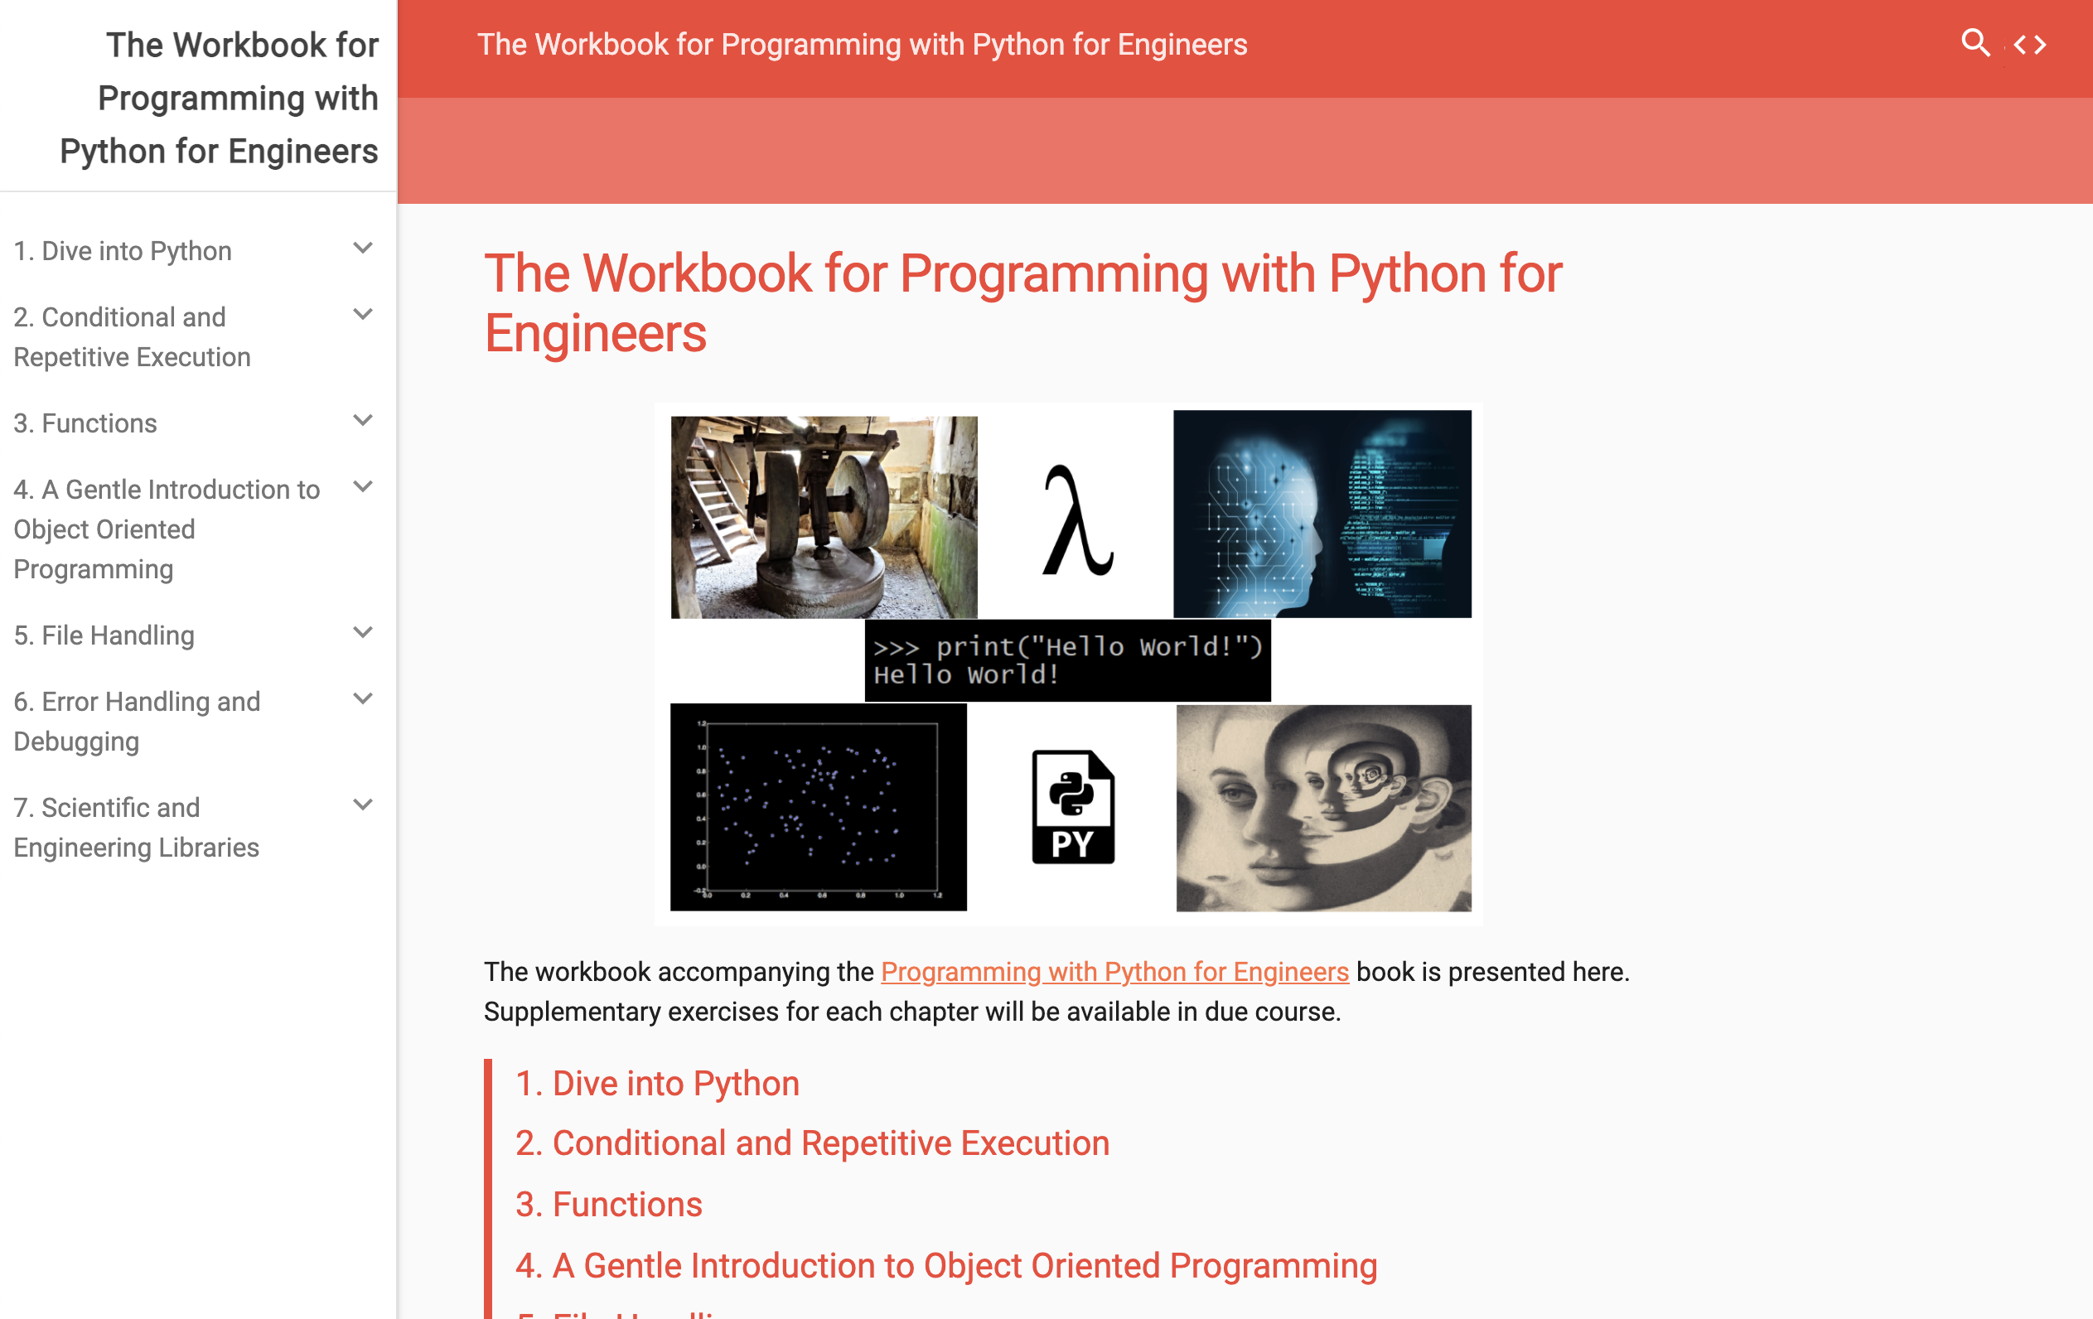
The workbook
https://pp4e-workbook.github.io/

Slide 5
basic computer organization

Slide 6
What is computing?
From the book:
“Computing is the process of inferring data from data. What is going to be inferred is defined as the task. The original data is called the input (data) and the inferred one is the output (data).”

Slide 7
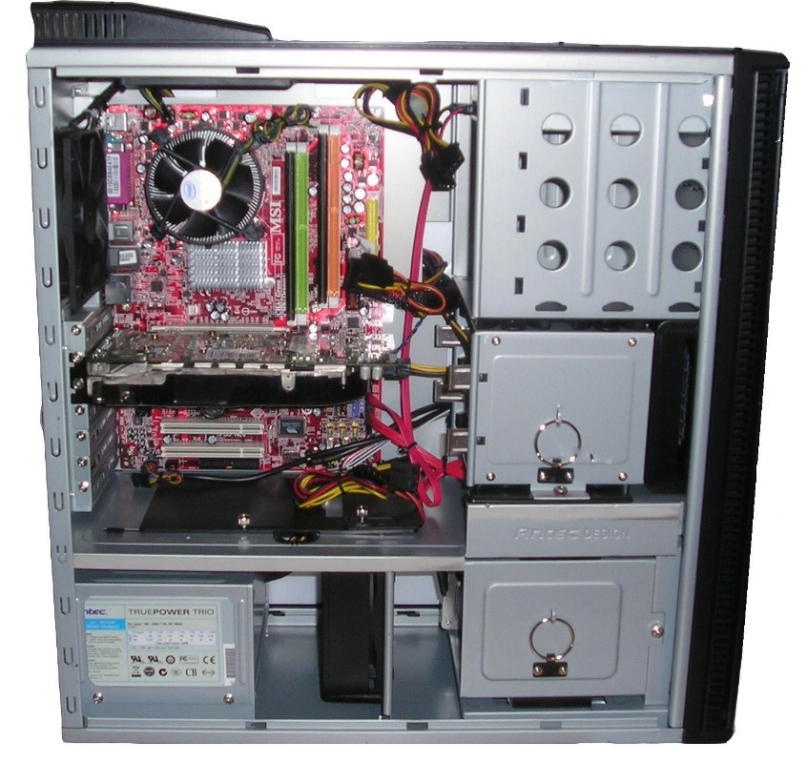
What is a computer?
The most common context: An electronic device that has a ‘microprocessor’ in it.
Binary
The broader context: Any physical entity that can do ‘computation’.
https://en.m.wikipedia.org/wiki/File:Computer_from_inside_018.jpg

Slide 8

What is a computer?
[Drawing by BruceBlaus - Own work, CC BY 3.0, https://commons.wikimedia.org/w/index.php?curid=28761830]

Slide 9
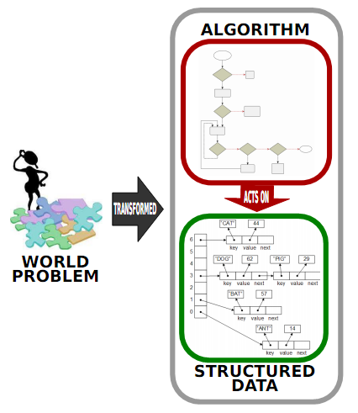
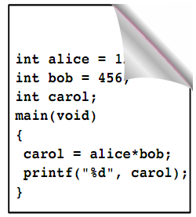
What is programming?
IMPLEMENTED
PROGRAM

Slide 10
What is a programming?
Program:
“a series of steps to be carried out or goals to be accomplished”
A recipe for cooking a certain dish is also a program (but not a computer program).

Slide 11
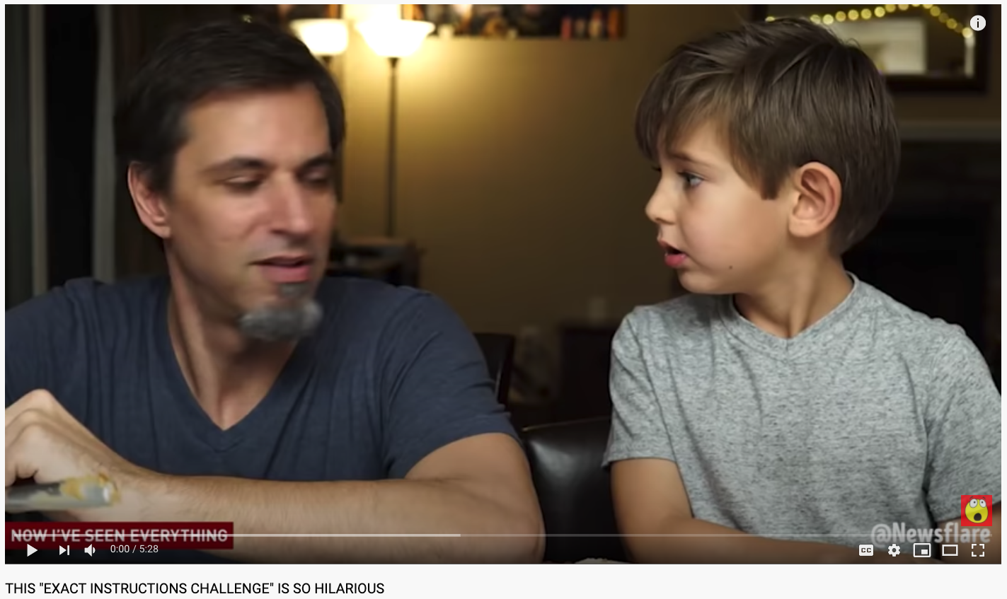
What is programming?
https://www.youtube.com/watch?v=Ct-lOOUqmyY

Slide 12
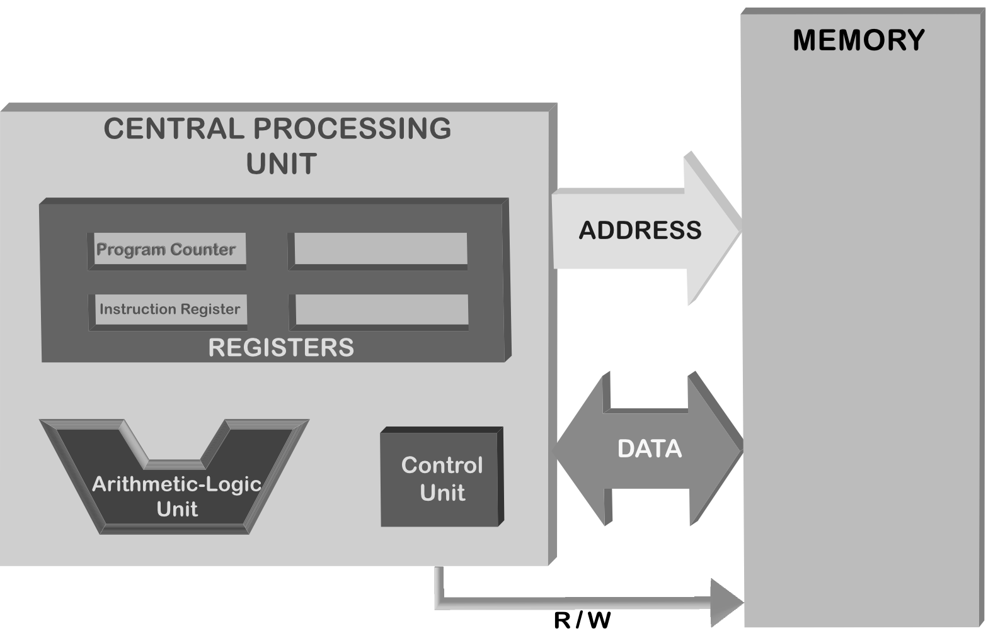
Von Neumann Architecture

Slide 13
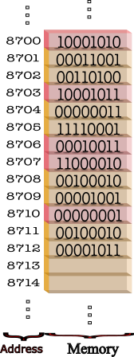
Memory
Random Access Memory (RAM)
Allows reading and writing operations
Each access requires an address

Slide 14
Central Processing Unit

Slide 15
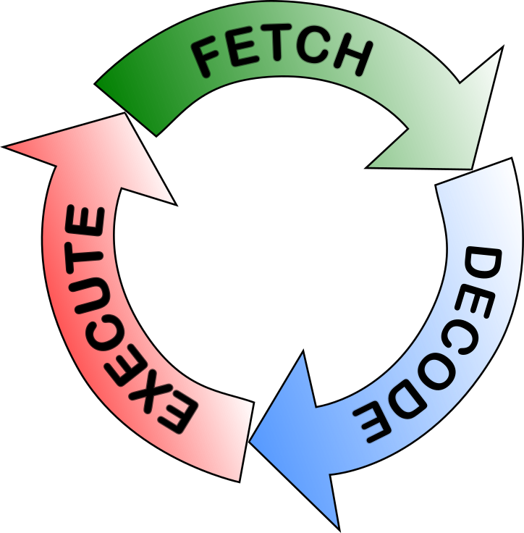
Fetch, decode, execute cycle
Fetch
Retrieve the next instruction from the memory
Decode
Look at the opcode of the instruction and decode what actions should be performed.
Execute
Execute the actions identified in the decode phase.

Slide 16
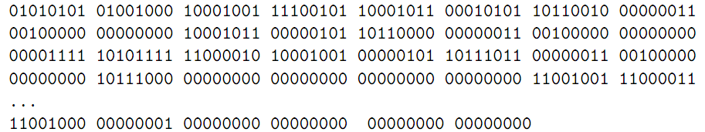
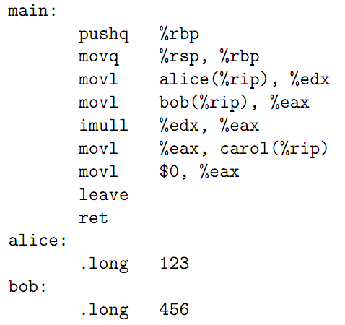
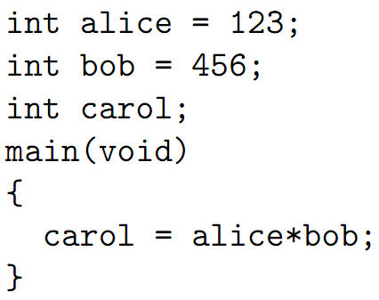
Stored Program Concept

Slide 17
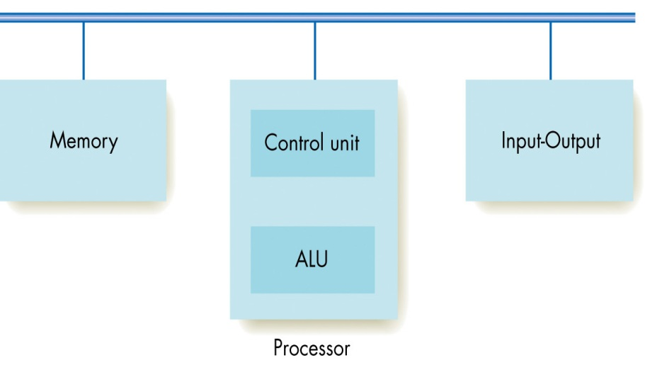
Peripherals of a Computer
All input-output devices are connected to the CPU via a wiring system called bus.
From: “Invitation to Computer Science” book by G. M. Schneider, J. L. Gersting

Slide 18
The running of a computer
BIOS (Basic Input-Output System) is loaded
Power-On Self Test (POST) is performed.
Checks CPU and RAM for errors
Identifies and initializes peripherals
Looks for an OS through the storage devices
Master Boot Record (MBR) of a disk contains a table and code piece for loading the OS on that disk
MBR is executed to load the OS.
BIOS and MBR are extended by
Unified Extensible Firmware Interface
GPT (GUID Partition Table)

Slide 19
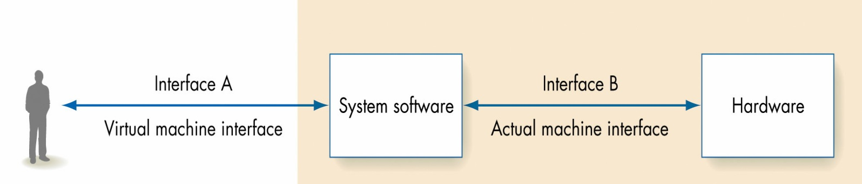
OS
From: “Invitation to Computer Science” book by G. M. Schneider, J. L. Gersting
Memory management
Process management
Device management
File management
Security
User interface

Slide 20
Final Words: Important Concepts
Computer, computing, programming.
The von Neumann Architecture.
The interaction between the CPU and the memory via address, R/W and data bus lines.
The crucial components on the CPU: The control unit, the arithmetic logic unit and the registers.
The fetch-decode-execute cycle.
The stored program concept.
Operating system and its responsibilities.

Slide 21
Final Words: Reading
The material at the end of the first chapter.
History of computing:
http://www.computersciencelab.com/ComputerHistory/History.htm
https://www.youtube.com/playlist?list=PL1331A4548513EA81

Slide 22
that’s all folks! Stay healthy

